Slide 1
NP problems and Approximate Algorithms

Slide 2
Decidability
Consider a decision problem whose answer is yes or no
Problems for which there exist algorithms to find the answer are decidable
Problems for which no algorithms exist to find the answer are undecidable
What is an example of an undecidable problem?
Halting Problem

Slide 3
Tractable
Decidable problems that can be solved in polynomial time; T(n)= O(n^{k}) are tractable
Others that take more than polynomial time are intractable

Slide 4
Expressing as Decision Problems
We can express many problems, particularly optimization ones as decision problems
Instead of saying find the minimum value, we rephrase it as is there a solution whose size is less than equal to n

Slide 5
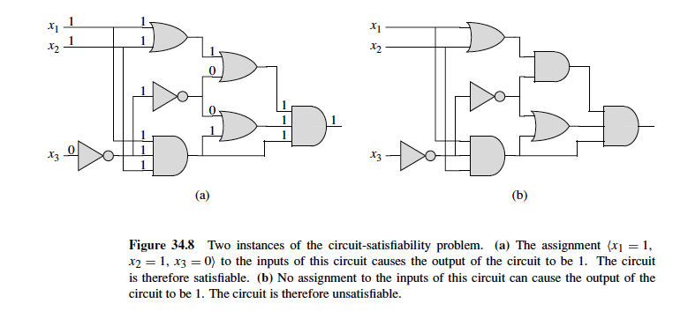
Circuit-SAT

Slide 6
Solving Circuit-SAT
Two steps
1. Guess the answer
2. Verify the answer
For all possible combination of the inputs, check whether the answer satisfies the circuit.
Checking the answer is polynomial time.
How many possible combinations to check ?

Slide 7
Characteristics of NP Problems
Verification can be done in polynomial time
Number of instances to check is larger than polynomial
If we could check all the instances non-deterministically, then problem is polynomial
NP=Non-deterministic Polynomial

Slide 8
NP Problems
The upper bound is larger than polynomial time
Is the lower bound polynomial ?
If yes then we can show P=NP
Answer is no known yet!

Slide 9
NP Complete Problem
Consider a set of NP problems : S
Let x is an element (a problem) in S
There is a polynomial time algorithm to transform any element in S to x
Then the problems in set S are NP-complete
So if we can solve one problem in the NP-complete set in polynomial time, we can solve all problems in the NP-complete set in polynomial time.

Slide 10
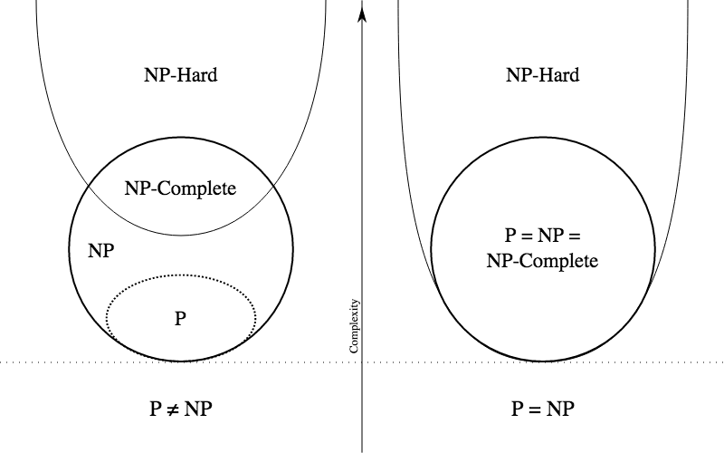
NP, NP-complete, NP-hard
NP-hard: The problem is at least as hard as NP
Every problem in NP can be reduced to a problem in NP-hard set

Slide 11
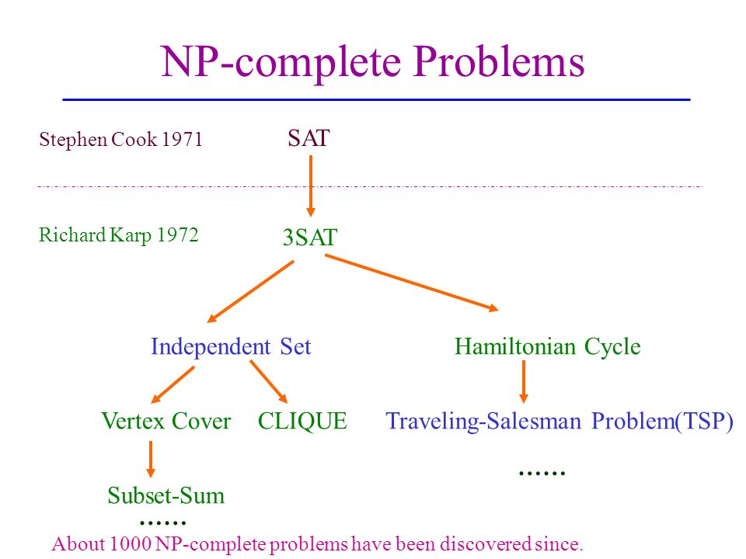

Slide 12
SAT=>3 SAT
Circuit Satisfiability (SAT):
Can be written as set of Boolean Clauses of any length
(x1 OR x2) AND (x3 OR x4 OR x5) AND (x6 OR x7 OR x8 OR x9)
3SAT:
All Clauses should be of length 3

Slide 13
SAT=> 3SAT
Convert clauses of size < 3
(x1OR x2) => (x1 OR x1 OR x2)
Convert clauses of size >3
(x6 OR x7 OR x8 OR x9)
=> (x6 Or x7 OR z1) AND (!z1 OR x8 OR x9)
(x1 OR x2 OR x3 …. OR xk)
=> (x1 OR x2 OR z1) AND (!z1 OR x3 OR z2) AND … (!zk OR x(k-1) OR xk)

Slide 14
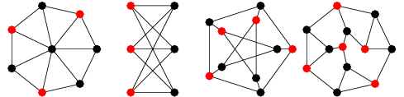
Independent Set
An independent set in a graph is a set of vertices no two of which are adjacent to each other
Does a given graph have an independent set of size >= K

Slide 15
3 SAT to Independent Set
3SAT instance with K clauses
(x1 OR x2 OR x3) AND (!x1 OR x2 OR !x3) AND (!x1 OR !x2 OR x3)
Create a triangle for each clause
Across triangles connect to negations of the same variables
The graph will have an independent set of size K if the given 3SAT formula is satisfiable
x1
!x1
!x1
x3
x2
!x3
!x2
x3
x2

Slide 16
Independent Set to Max Clique
Is there a clique of size >=K in a graph
Take a graph
Take the complement of the graph (connect vertices that were not connected; remove connections between vertices that were connected)
Find the independent set of the complement graph
The vertices that form the independent set in the complement graph form the clique in the original graph
Independent set in the original graph=max clique in the complement graph

Slide 17
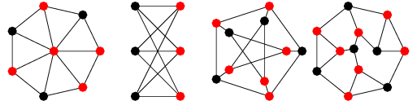
Vertex Cover
If K is an independent set in G (V,E), then V-K is a vertex cover in G’

Slide 18
Max ClIQUE to VERTEX COVER
Given a graph G, with V vertices, let the max clique be formed of the set of vertices C
Now create the complement of the graph, say G’.
Any edge in G’ will have at least one end point not in C.
Thus the size of the independent set is at least |V|-|C|

Slide 19
Graph Coloring
Assign a color to each vertex of a graph, such that two adjacent vertices do not have the same color (vertex coloring)
The minimum number of colors with which the vertices of a graph can be colored is called the chromatic number of the graph, 𝜒(G).
Graph coloring is used for resources allocation
Least number registers in computing
Fewest rooms to be allocated
Fewest channels in mobile transmission

Slide 20
Bounds on Graph Coloring
Let H be a subgraph of the graph G, then 𝜒(H) <= 𝜒(G)
If G (V,E) is a cycle then 𝜒(G)=2 if then |V| is even and 𝜒(G)=3 otherwise
If G (V,E) is a clique of n vertices then 𝜒(G)=n.
𝜒(G)<=1+ max degree of graph

Slide 21
3 SAT to Graph Coloring
B
The truth gadget is a triangle with three vertices T, F, and X, which stand for TRUE, FALSE, and OTHER. Since these vertices are all connected, they must have different colors in any
3-coloring.
F
T
X
The variable gadget for a variable a is a triangle joining two new nodes labeled a and !a to node X in the truth gadget. Node a must be colored either TRUE or FALSE, and so node !a must be colored either FALSE or TRUE, respectively.
A
!A
A clause gadget joins three literal nodes to node T in the truth gadget using five new unlabeled nodes and ten edges.
In any valid three coloring, at east one of the literal nodes should be true.

Slide 22
3 SAT to Graph Coloring
(a OR b OR c) AND (b Or !c Or !d) AND (!a OR c OR d) AND (a OR !b OR !d)

Slide 23

Approximation Algorithms
We can find a close near-optimal solution to many NP-complete problems with polynomial time algorithms.
Approximation algorithms provide performance ratios of the obtained solution (C) to the optimal solution (C*)

Slide 24
Approximation Algorithms vs Heuristics
Approximation algorithms provide an approximation ratio of how close the solution is
Heuristics do not provide any such ratio
Not all NP-complete problems can be approximated within a polynomial factor—e.g. Independent Set problem

Slide 25
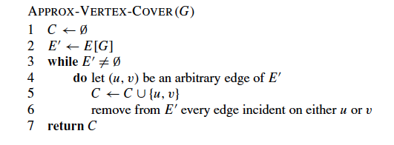
Approximation Algorithm for Vertex Cover

Slide 26
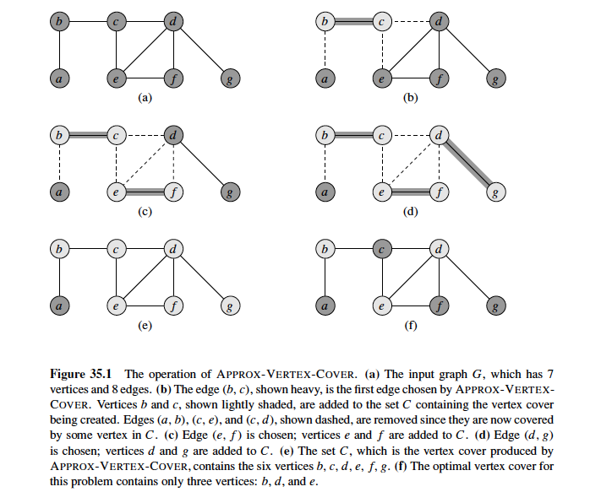

Slide 27
Approximation Factor
Vertex cover is a polynomial time 2-approximation algorithm
Let A be the set of edges selected by the algorithm
Then no two edges in A share an end-point
The optimal solution C* includes at least one end point to each edge
Therefore no two edges in A are covered by the same vertex in C*; |C*| >= |A|
In the algorithm we pick the vertex cover C, by taking the two end points of A; |C|=2|A|
Together |C| <= 2|C*|

Slide 28



Travelling Salesman Problem
We assume triangle inequality, i.e.

Slide 29
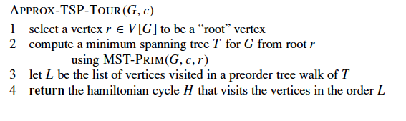
Travelling Salesmen Problem with Triangle Inequality

Slide 30
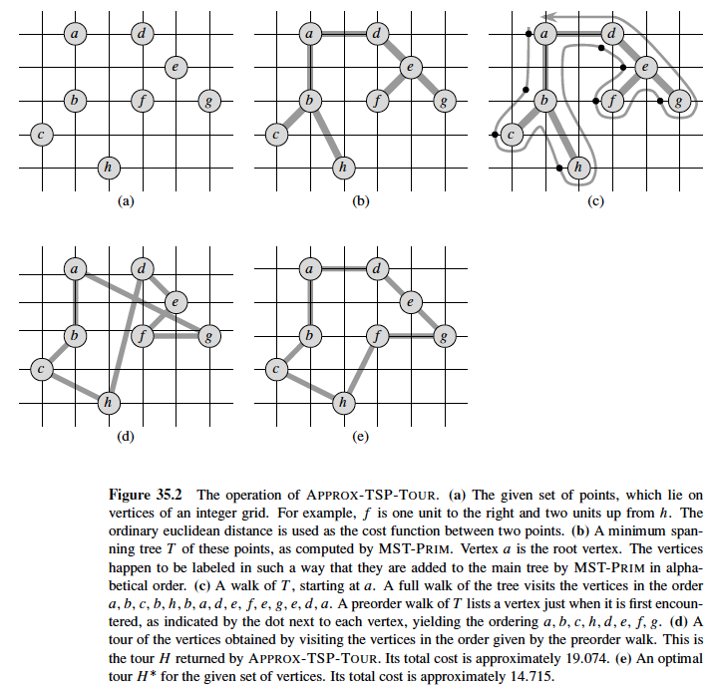

Slide 31
Approximation Factor
The given algorithm is a ploynomial time 2-approximation algorithm for TSP with triangle inequality.
Let H* be the optimal cycle
A minimum spanning tree is an acyclic graph with total least edge cost. Let the cost of MST be T c(T) <=c(H*)
A full walk, W, of T visits every edge in T twice, c(W)=2c(T)
Together c(W) <= 2c(H*)

Slide 32
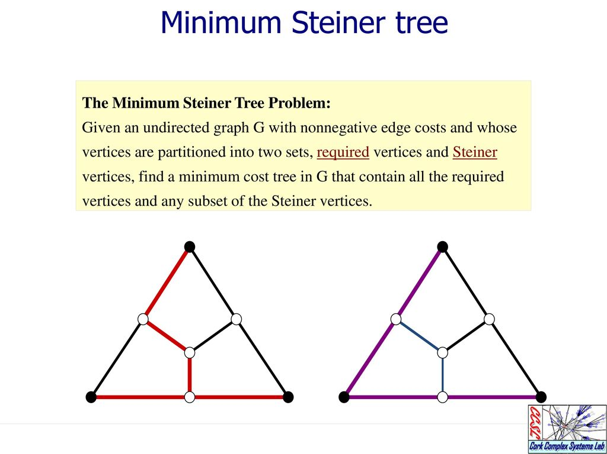
https://slideplayer.com/slide/12644632/

Slide 33
Special Cases
Required vertex = 1 (Trivial case)
Required vertex =2 (Single Source Shortest Path)
Required vertex = V (Minimum Weighted Spanning Tree)
General Problem is NP complete

Slide 34
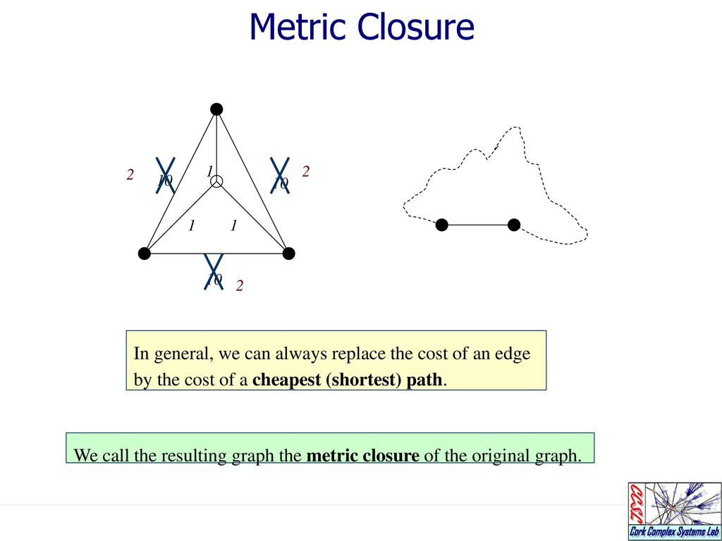

Slide 35
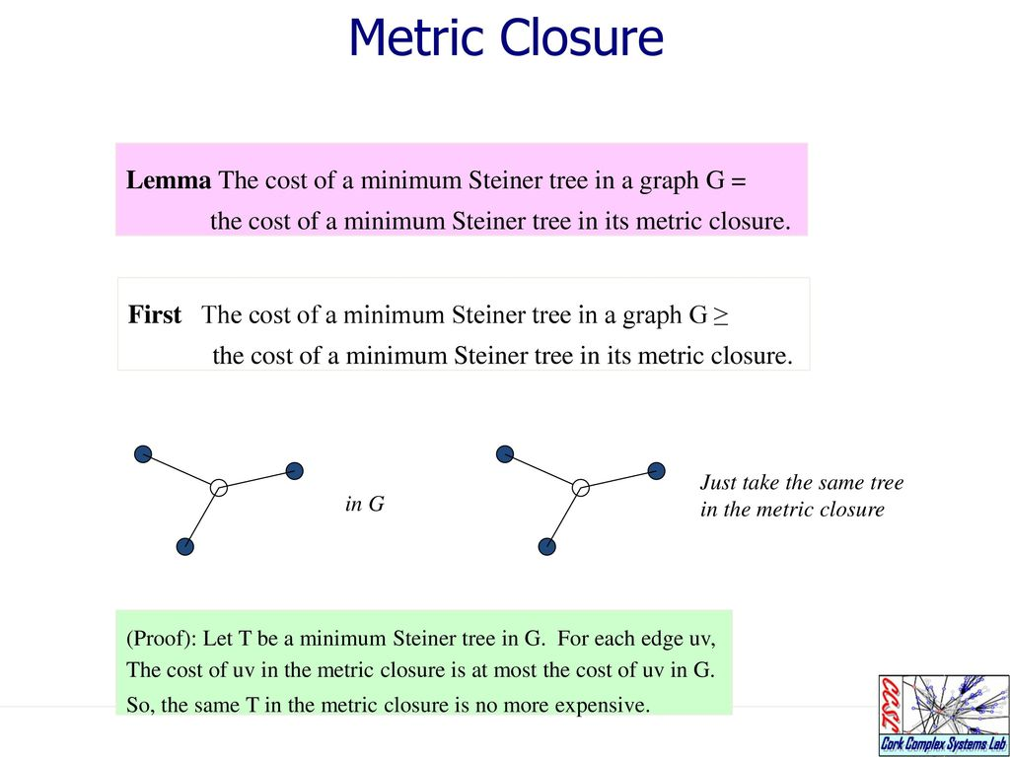

Slide 36
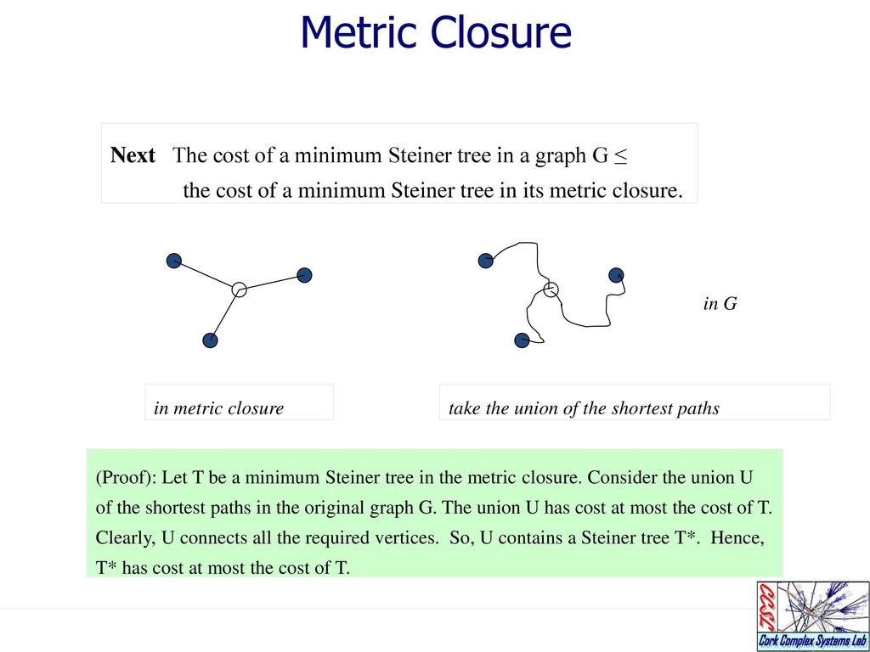

Slide 37
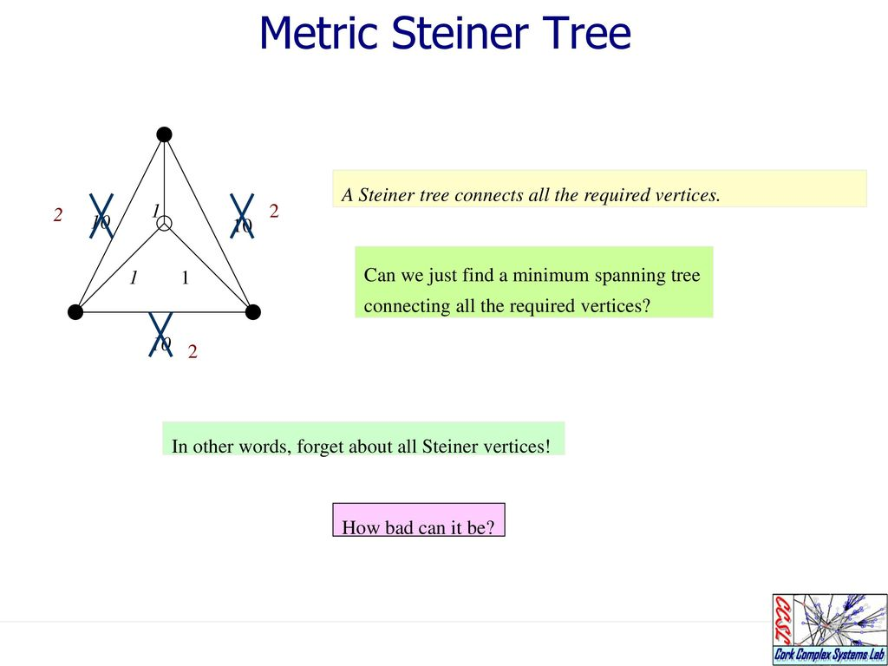

Slide 38
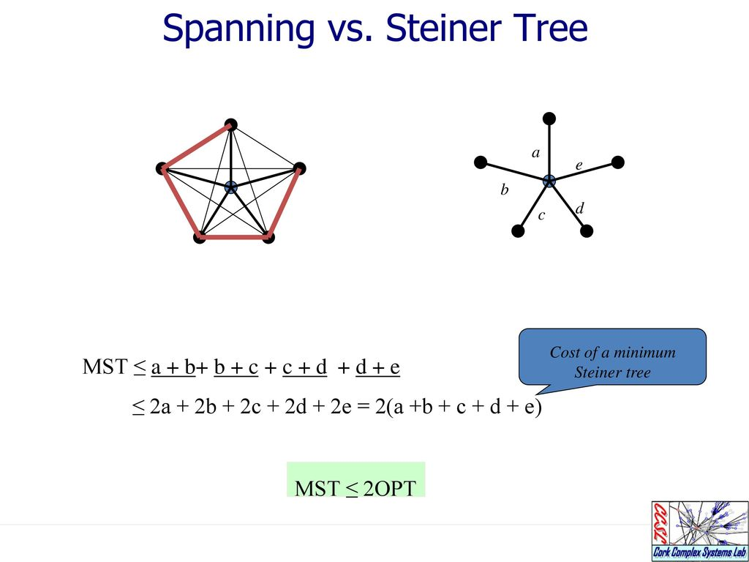

Slide 39
